Slide 1
Solids, Liquids and Gases

Slide 2

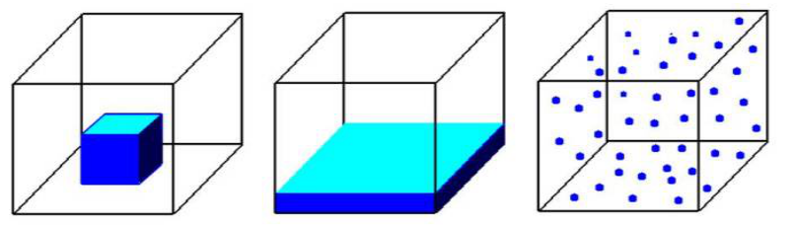
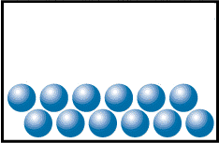
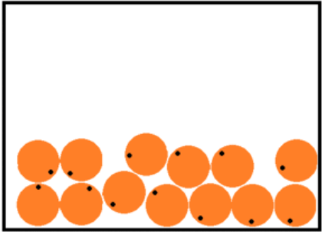
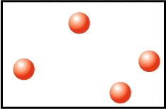
Solids, liquids and gases
Fixed shape
Fixed Volume
Not compressible
Regular pattern (lattice)
Particles close together
Particles vibrate
Shape of container
Fixed Volume
Not compressible
Irregular pattern
Particles close together
Particles flow or slide
Shape of container
No Fixed Volume
Compressible
No pattern
Particles far apart
Particles move freely and quickly

Slide 3
Phases of matter
Solid
Liquid Gas
Melting
Sublimation
Freezing
(fusion)
Fusion
Boiling
Condensation

Slide 4
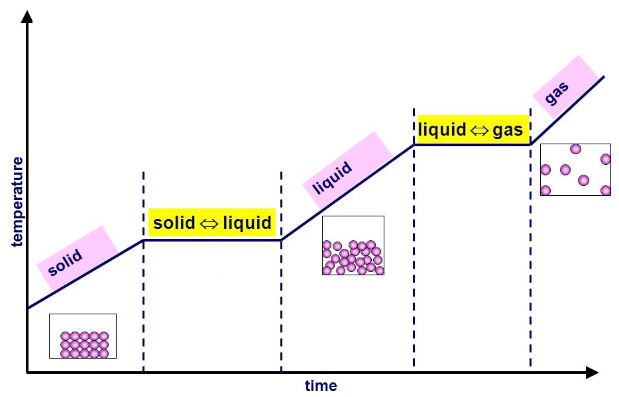
Phases of matter

Slide 5
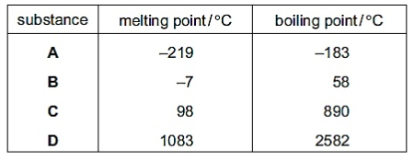
States of Matter and M.P./B.P.
What states are the following substances at:
  -100°C
  +50°C
  +900°C
-100°C
gas
solid
-100°C
solid
-100°C
solid
-100°C

Slide 6
States of Matter and M.P./B.P.
What states are the following substances at:
  -100°C
  +50°C
  +900°C
+50°C
gas
+50°C
liquid
solid
+50°C
solid
+50°C

Slide 7
States of Matter and M.P./B.P.
What states are the following substances at:
  -100°C
  +50°C
  +900°C
+900°C
gas
+900°C
gas
+900°C
gas
solid
+900°C

Slide 8
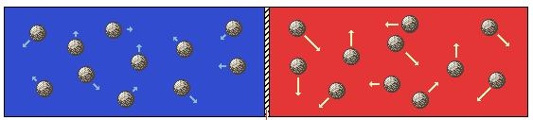
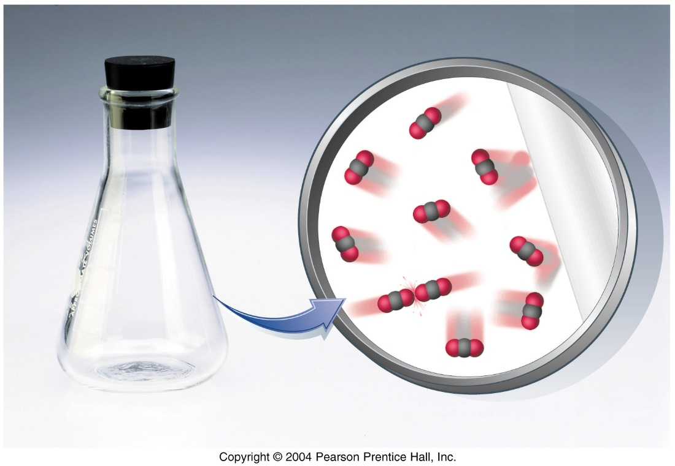
Kinetic Theory
Low temperature gas
low kinetic energy
low speed
High temperature gas
high kinetic energy
high speed
Temperature: related to average speed of gas molecules.
Pressure: collision of gas molecules with wall of container.
Molecules move in straight lines until they collide.
Molecules are in rapid, random motion.

Slide 9
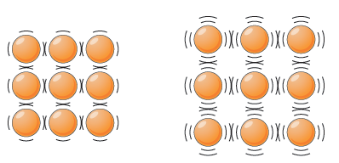
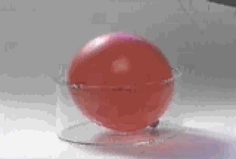
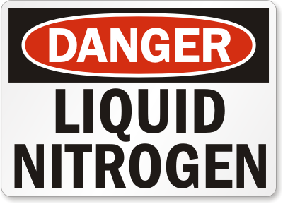
Lowest Temperature
The coldest anything can be is -273ºC (absolute zero)
At that temperature no vibration of particles happens at all
HEAT

Slide 10
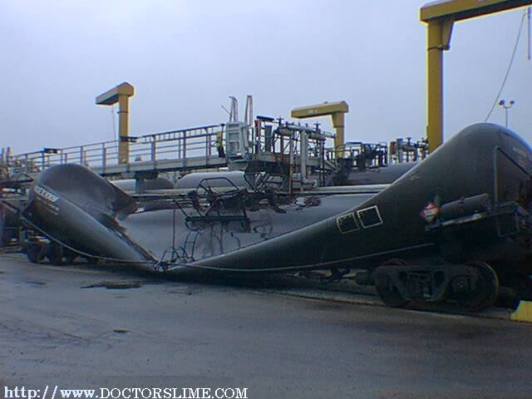
Atmospheric air pressure
This railway tanker, was sealed after steam cleaning. It collapsed under the effect of air pressure as the steam inside condensed to water.

Slide 11
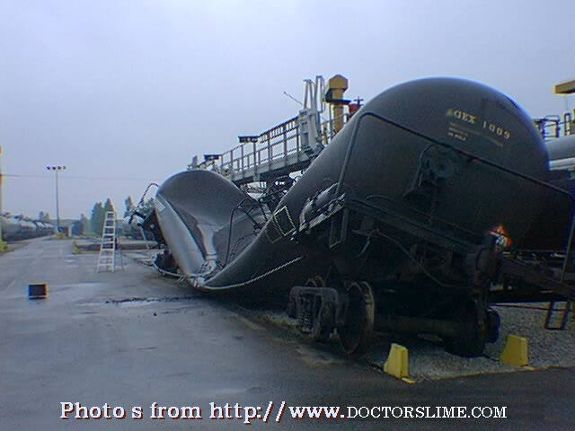
Atmospheric air pressure

Slide 12
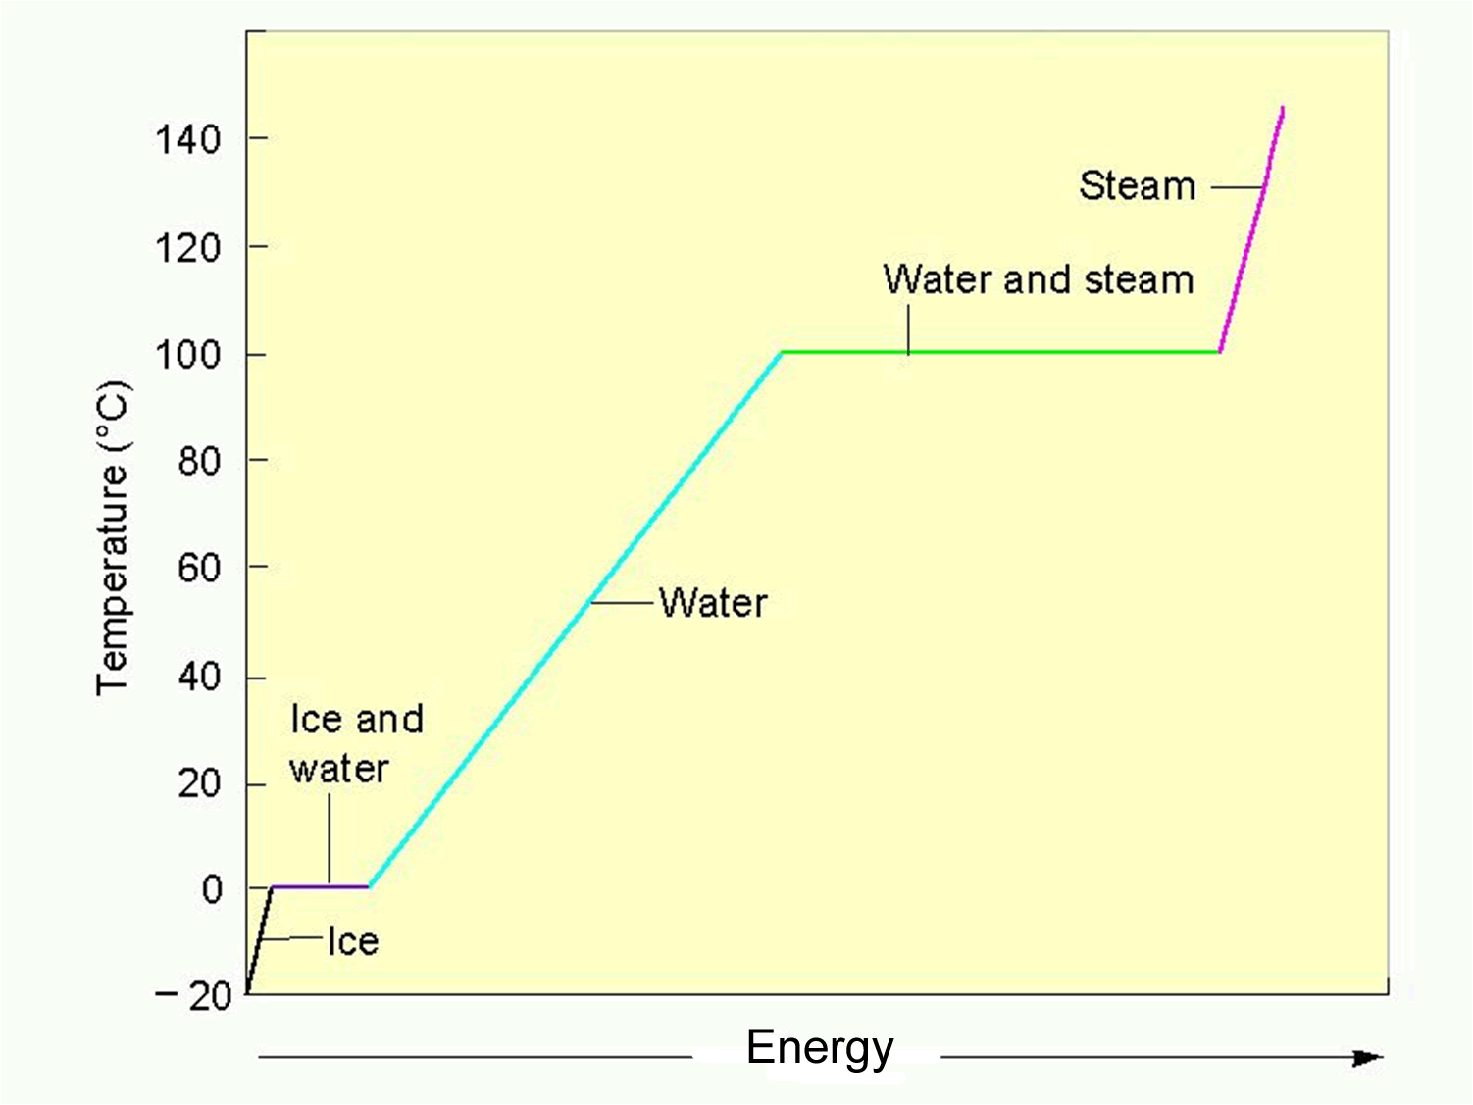
Water phase changes
Increasing
Potential energy
Constant
Kinetic energy
Temperature
Increasing
Kinetic energy
Temperature
Constant
Potential energy
constant
Temperature remains _______ during a phase change.

Slide 13
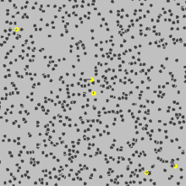
Brownian motion
Random motion of particles in a suspension (Brownian motion)

Slide 14
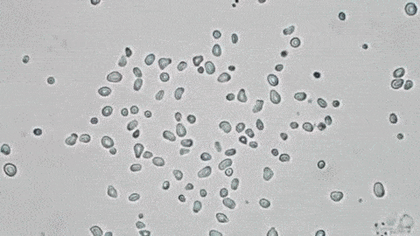

Robert Brown 1771 – 1858
Brownian Motion
pollen grains in water
Brownian Motion
dust in bright sunlight

Slide 15
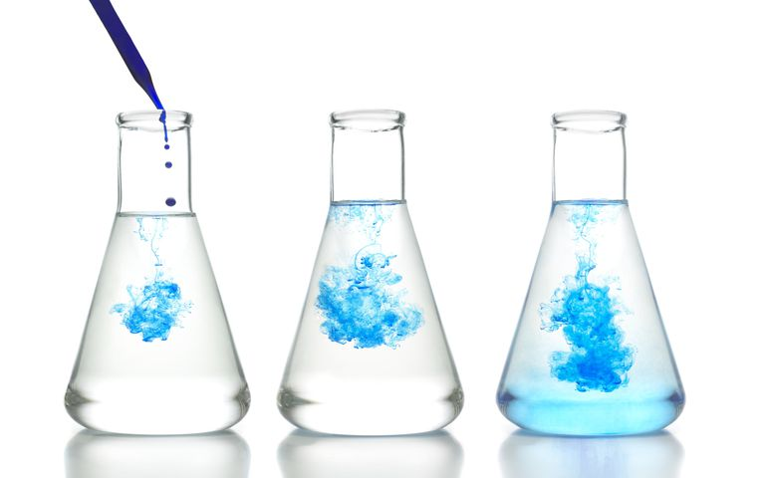
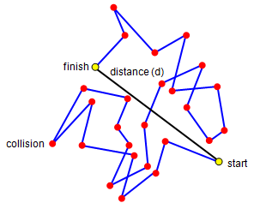
Diffusion
Diffusion is the movement of matter or energy from an area of higher concentration to an area of lower concentration.
It is slower than predicted by molecular speeds due to the frequent collisions of molecules.

Slide 16
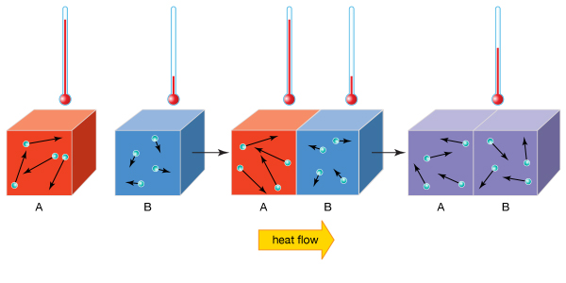
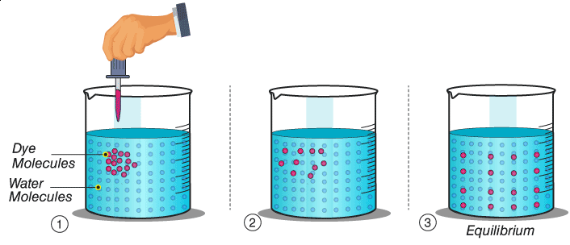
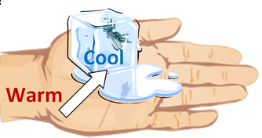
Diffusion

Slide 17
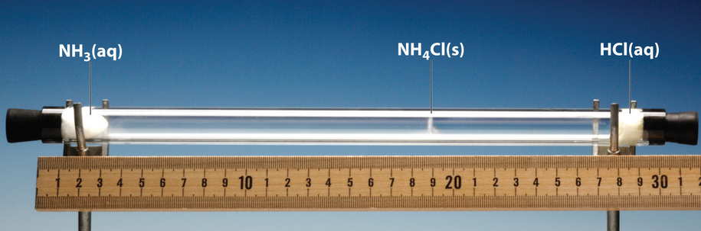
Diffusion
NH₃ (g) + HCl (g) → NH₄Cl (s)
Approximately where does the NH₄Cl (s) form?
1 2 3
↓ ↓ ↓
temperature
Molecular mass and ____________ affect diffusion time

Slide 18
Evapouration, Boiling and Cooling

Slide 19
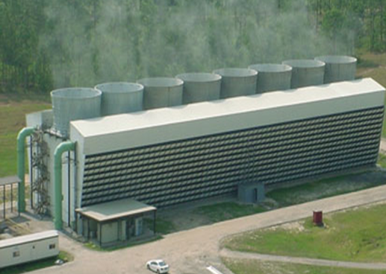
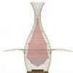
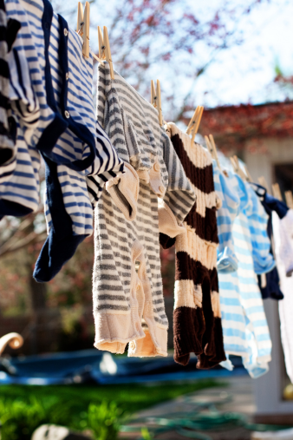
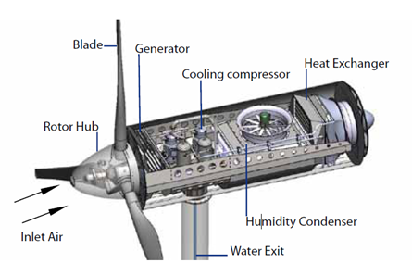
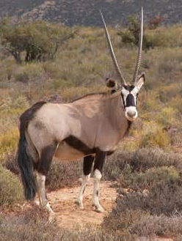
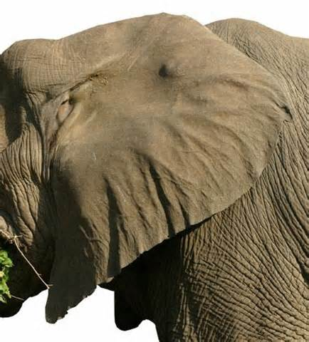

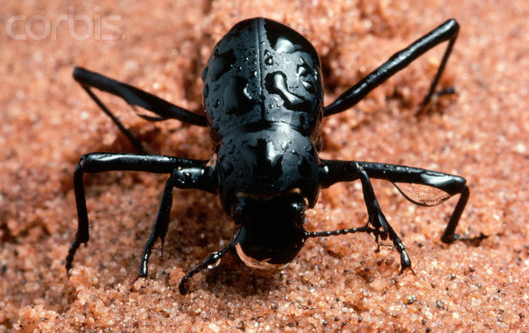
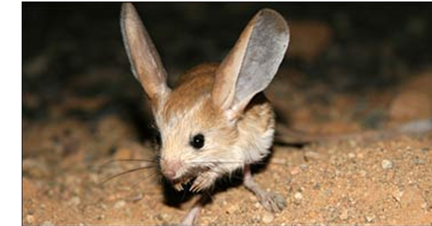
What do all these have in common?

Slide 20
Evapouration
Evapouration is when a liquid changes to a gas below the boiling point of the liquid
It only occurs at the exposed surface of a liquid and it is affected by:
  the temperature of the liquid
  air movement
  humidity
When particles evaporate from the surface of a liquid, the remaining liquid is cooler because it has less energy.
This is called evaporative cooling.

Slide 21
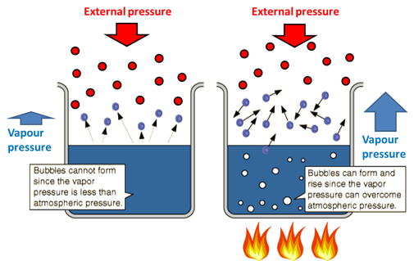
Evapouration
Bubbles cannot form since the vapour pressure is less than the atmospheric pressure
Bubbles can form and rise since the vapour pressure can overcome the atmospheric pressure

Slide 22
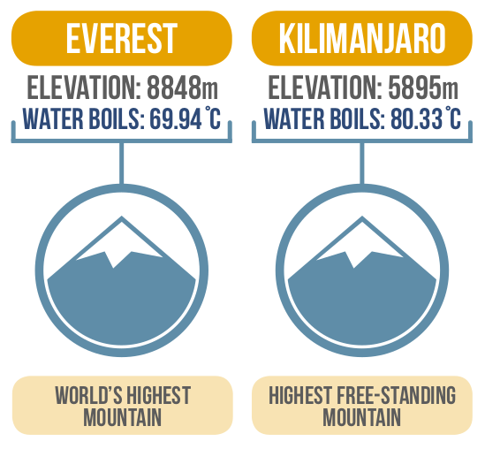
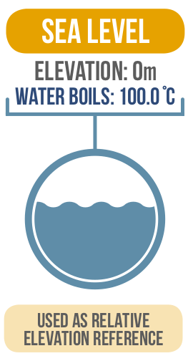
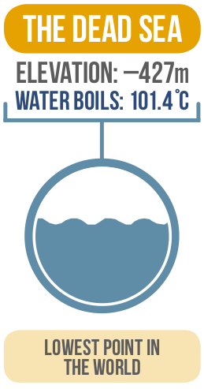
Evapouration

Slide 23

Evapouration
What are the factors which affect the rate at which laundry dries due to evaporation?
Folded/unfolded surface area
Amount of heat added
Air temperature
Wind – convection currents
Relative humidity

Slide 24
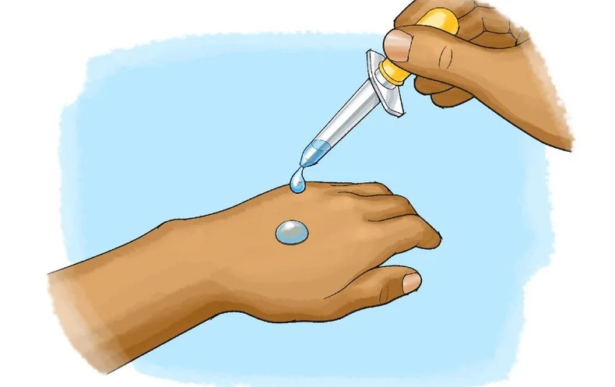
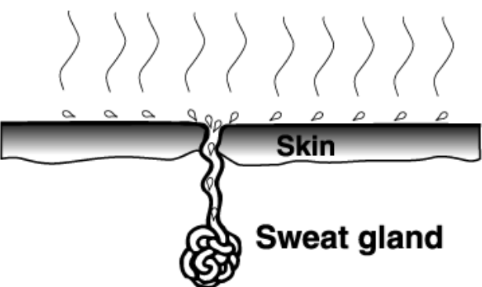
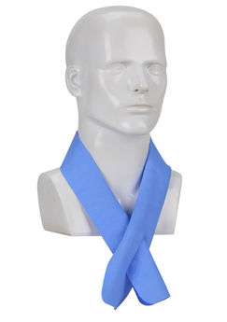
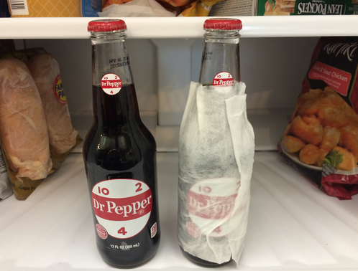
Evapouration
What’s the connection?
Evapourative Cooling

Slide 25

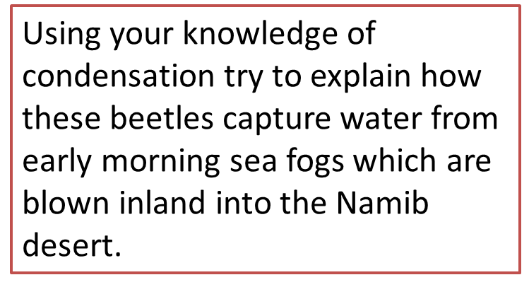
Air blown in from Sea has a lot of water vapour.
The surface of the beetles is cold because black re-radiates heat rapidly at night.
Because the surface is cold, the water vapour in the fog loses kinetic energy and changes from a gas to a liquid.

Slide 26
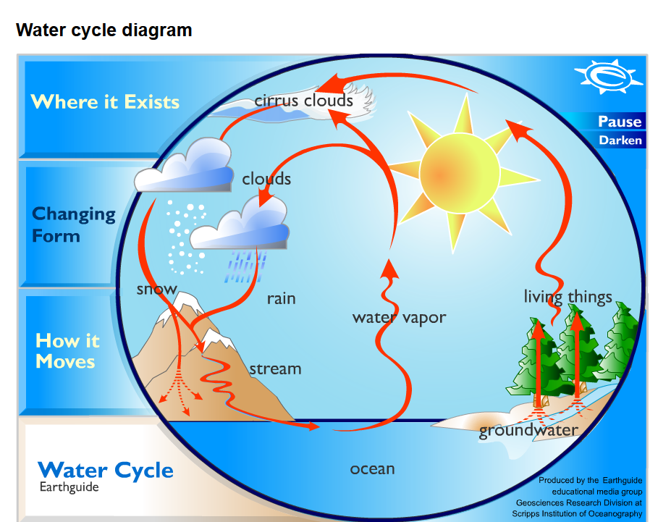
Water cycle

Slide 27
Conduction Convection and Radiation

Slide 28
Lowest Temperature
Temperature is a measure of the heat of an object.
When an object has more heat, the particles move faster.
The coldest anything can be is -273ºC (absolute zero)
At that temperature no vibration of particles happens at all
HEAT

Slide 29
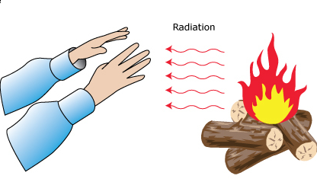
Heat Flow

Slide 30

Heat Flow
Let’s make it slightly more complicated. Consider a cup of coffee:
This cup will keep giving energy out until it is in thermal equilibrium with the room – i.e. they are both the same _________.
Thermal equilibrium is called a “_____ equilibrium”. This means that _____ is still being transferred between the cup and the room but the net transfer is ____ (the opposite of this is called a “______ equilibrium”).
Words – temperature, static, zero, energy, dynamic

Slide 31
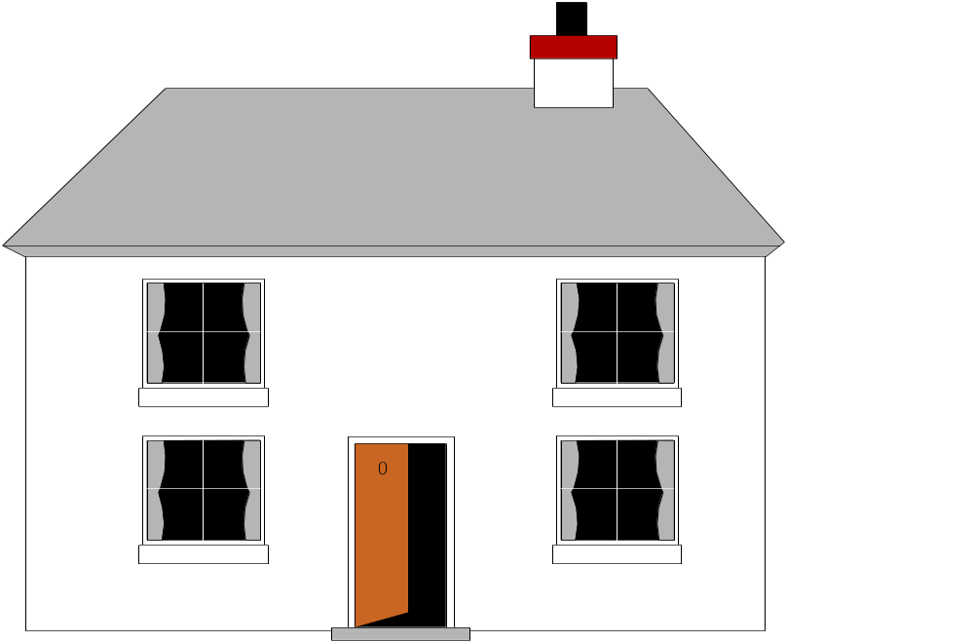
Steady State
Consider a house:
My house is nice and warm. It’s 20^{O}C in here.
It’s freezing out here! In fact, its 0^{O}C
Can I go in yet?
Let’s say the walls of the house stay at about 10^{O}C. This means that there is a steady energy flow from the inside to the outside – if these temperatures and energy flows stay constant then we call this “steady state”.

Slide 32
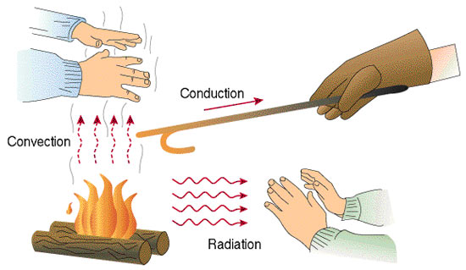
Heat Energy
Heat energy flows from hot regions to cold regions by:

Slide 33
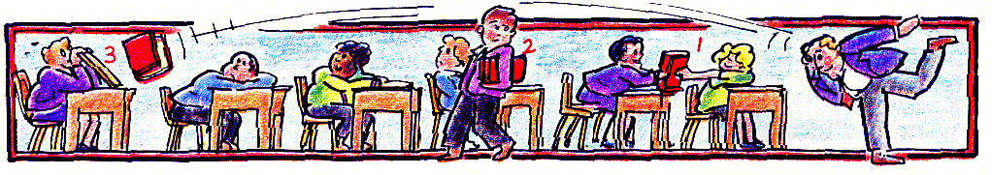
A model of heat transfer processes
1. CONDUCTION
– book passed from student to student.
2. CONVECTION
– book taken a student to the back of the room.
3. RADIATION
– book thrown to the back of the room.

Slide 34
Conduction

Slide 35
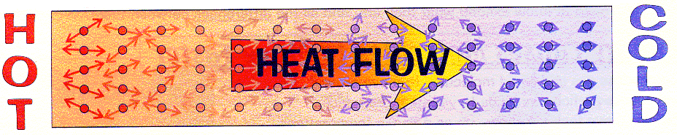
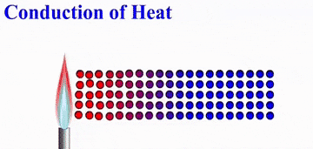
Conduction
Conduction occurs in solids, the particles do not translate
Particles vibrate more when hot
Stronger intermolecular forces allow the vibrations to travel faster
A poor conductor is called an insulator
Solids (best) → liquid → gas → vacuum (worst, no conduction)

Slide 36
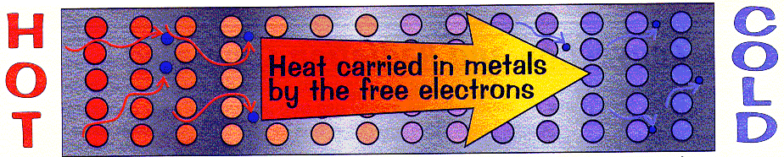
Conduction through metals
Metals are excellent conductors because they have free electrons.
The free electrons can pass energy through the metal very quickly.
Most of the best conductors are metals.
However, diamond, a non-metal, is the best conductor despite only using transferring energy by vibrations.

Slide 37
Rate of heat transfer
copper
copper
60°C
glass
20°C
100°C
copper
Heat transfer by conduction can increased by:
  using a better conducting substance
  decreasing the thickness of the substance
  increasing the area of the substance
  increasing the temperature difference across the substance

Slide 38
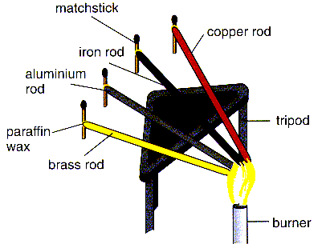
Finding the best conductor
Independent variable
material
Dependent variable
time for match to fall off
Constants
length
cross-sectional area
heat energy supplied

Slide 39
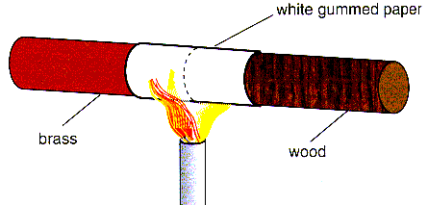
Comparing brass & wood
Which sides burns the paper the quickest?
The wooden side, because the brass removes the heat away from the paper more quickly than the wood.

Slide 40
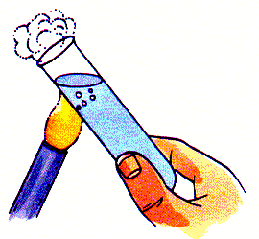
Water - a poor conductor
Why is it possible to hold the bottom of the tube even though the water is boiling at the top?
Water (and glass) conduct heat relatively slowly

Slide 41





What's the connection?
Air
- a good insulator
Air trapped in feathers, cavity wall insulation, loft insulation, duvets and lagging greatly reduces heat loss by conduction.

Slide 42
Question 1
Choose appropriate words to fill the gaps below:
Conduction is the main form of ______ transfer in solids. This is because the molecules are relatively _______ together.
Extra heat energy makes the molecules __________ more. They pass on their extra vibrational energy to neighbouring ______________.
Metals are __________ conductors of heat energy because they contain many free __________ which can move through the solid and ____________ energy.
The electrons give up their energy when they ___________ with other molecules.
heat
close
move
molecules
good
electrons
transfer
collide
WORD SELECTION:
close
heat
good
collide
molecules
transfer
move
electrons

Slide 43
Question 2
Write down three insulating materials and three conducting materials as well as their uses in the table below:
substance | conductor or insulator | use
copper
conductor
cooking pan bases
feathers
insulator
keeping birds warm
water
conductor
cooling hot substances
fibre glass
insulator
roof insulation
steel
conductor
radiators
air
insulator
clothing

Slide 44
Question 3
Explain why
newspaper wrapping keeps hot things hot, e.g. fish and chips, and cold things cold, e.g. ice cream,
fur coats would keep their owners warmer if they were worn inside out,
a string vest keeps a person warm even though it is a collection of holes bounded by string,
a concrete floor feels colder than a carpeted one even though they are at the same temperature.

Slide 45
Convection

Slide 46

Convection in fluids
Particles translate from hot regions to cold regions
Convection does not occur in solids, it only occurs in fluids (liquids/gases)
Hot particles move more quickly than cold particles
Hot particles occupy more space than cold particles
Hotter fluids are less dense than colder fluids
Hotter fluids rise up to float on top of colder fluids
A convection current is the path taken by rising hot fluids and sinking cold fluids

Slide 47


Slide 48


Convection in water
Describe what is happening

Slide 49

House water heating system
Describe what is happening
The boiler heats the water.
Hot water rises to the top of the boiler and up to the top of the storage tank.
Colder water in the tank falls to the bottom of the boiler to be heater.
A hot water tap draws water from the top of the storage tank.
The cold water supply replenishes the hot water drawn off.

Slide 50


Hot air rises
Heated air provides lift for a hot air balloon.
Heated land causes rising air currents called thermals.
Thermals can be used by gliders to provide lift.
Many birds also use thermals for lift.

Slide 51


Sea and land breezes
During a hot day heated air rises up from land that is warmer than the sea.
Cooler air moves in from the sea to replace the heated air. This is the sea breeze.
At night the sea is often warmer than the land.
Air now flows to the sea. This is called a land breeze.

Slide 52

Simple mine ventilation
hot air rising
fresh air
The fire causes hot air to rise up the shaft above it.
Cooler, fresher air is drawn down the other shaft..

Slide 53
Question 1
Choose appropriate words to fill in the gaps below:
Convection is a method of heat transfer that only occurs in ________ (liquids and ________).
When part of a fluid is heated the ___________ in that region move more ______ and take up more space. The heated fluid expands and becomes less _______ than the surrounding cooler fluid. The heated fluid _______ on top of the cooler fluid.
The upward path of the heated fluid is called a ____________current.
fluids
gases
molecules
quickly
dense
rises
convection
WORD SELECTION:
gases
convection
dense
molecules
rises
fluids
quickly

Slide 54

Convection
Convection is all about when a gas or liquid (“fluid”) moves and carries heat with it. When the fluid is heated it ____________. This means that it will become less __________ than the colder fluid around it. Because of this the warmer fluid will try to “_______” over the colder fluid, and this is why warm air rises. This is called a convection ___________. This is how heat reaches us from the ___________ in this room.
In CONDUCTION the heat was passed on by VIBRATIONS in a SOLID
In CONVECTION the heat is passed on by the FLUID expanding, rising and TAKING THE HEAT with it
Words: expands, radiators, dense, heated, current, float

Slide 55
Question 2
Explain why
a hot drink will cool more slowly if a lid is put on the top of the drink,
clouds are often formed at the top of thermals,
top loading freezers are more efficient than those with side doors,
hot water radiators are best placed\under a window.

Slide 56





Question 3
1
2
Which position keeps the berries frozen the longest if there is a power cut? And why?
1 is best
2 and 4 gain heat energy by conduction
3 has less air insulating at the front side
3
4

Slide 57
Radiation

Slide 58
Radiation
An introduction…
I’m cool!
I’m very hot!

Slide 59


Thermal radiation & temperature
All objects above absolute zero (-273 ºC) give off thermal radiation.
The hotter an object the more radiation it gives off.

Slide 60

Properties of thermal radiation
Radiation is the movement of heat energy from a hot to a cold region by means of electromagnetic waves or infra-red (IR) Radiation travels equally in all directions
Radiation travels far more quickly than the other forms of heat transfer
Radiation is the only type of heat transfer that can travel through a vacuum.
Radiation travels fastest through a vacuum where its speed is that of light (300 000 km/s or 186 000 miles per second).
In General: Vacuum > gases > liquids > solids

Slide 61




Detecting thermal radiation

Slide 62



Detecting thermal radiation
Rice taken out of the rice cooker and put on the counter, and then moved to the right. You can see the warm spot where it was.
A woman with her coffee.
A hand print on the counter, and a cold spot made by an ice cube put down and then taken away

Slide 63


Infra-Red Vision
The reason cats sit on laptops and other electrical equipment is because they can see that they are warm

Slide 64


Radiation Emission and Absorbtion
All objects emit (give out) some thermal radiation.
best emitter
worst emitter
matt
black
white
silver
This wolf absorbs heat well because of his dark coat
Space blankets use this property of reflecting and emitting radiation

Slide 65


Surface and emission
Darker surfaces emit and absorb radiation better than bright surfaces.
Rough surfaces emit and absorb radiation better than polished surfaces.

Slide 66



Silvered surfaces
A metal kettle, a firefighter and a marathon runner make use of silvered surfaces.

Slide 67

Question 1
Explain why
heat from the Sun can only reach us by thermal radiation,
in hot countries houses are often painted white,
car radiators are black,
solar cells are black.

Slide 68
Question 2
Choose appropriate words to fill in the gaps below:
Thermal radiation, also known as __________ radiation, is how heat travels by _____________ waves.
Radiation travels equally in all ________and most quickly through a __________ where its speed is ___________ km/s.
All objects above absolute zero ( ________ ºC ) give off thermal radiation.
Hot, _______ and rough surfaces emit radiation best.
Bright and ___________surfaces reflect radiation best.
heat
electromagnetic
directions
vacuum
300 000
- 273
dark
smooth
WORD SELECTION:
electromagnetic
vacuum
- 273
heat
directions
300 000
dark
smooth

Slide 69


Radiation
Radiation is when heat moves around in electromagnetic _________ like light does. Any hot object will emit heat radiation – the hotter it is, the more radiation it emits. This type of radiation is called __________, and too much of it will cause _________. Dark, matt colours will absorb AND emit the _____ infra-red radiation, and light, shiny colours will ________ it.
The main difference with radiation is that conduction and convection could ONLY happen in solids, liquids or gases, whereas radiation will happen through an _____ _____. This is just as well, as otherwise we wouldn’t be able to get any heat from the ___.
Words – sun, reflect, infra-red, waves, most, empty space, sunburn
Anything HOT emits HEAT RADIATION – the hotter it is, the more infra red radiation it emits

Slide 70
True or False Questions
Radiation travels in straight lines
True/False
Radiation can travel through a vacuum
True/False
Radiation requires particles to travel
True/False
Radiation travels at the speed of light
True/False

Slide 71
Conduction, Convection and Radiation

Slide 72



Heating a room using a water radiator
Hot water heats the metal radiator by conduction.
The outer metal surface heats air in contact by conduction and radiation.
Hot air circulates a room by convection.

Slide 73

The Greenhouse
The ‘Greenhouse Effect’ is where gases such as carbon dioxide in the Earth’s atmosphere have the same effect as the glass of a greenhouse.

Slide 74


Reducing heat transfer using a vacuum flask
Vacuum flasks
keep hot things hot and cold things cold
CONDUCTION
– reduced by the vacuum, plastic top, glass and air spaces
CONVECTION
– reduced by the vacuum, plastic top and the trapped air spaces
RADIATION
– reduced by the silvered glass walls
EVAPOURATION
- reduced by plastic top

Slide 75
Reducing heat transfer using a vacuum flask
Vacuum flasks
keep hot things hot and cold things cold
Good insulator = reduced conduction
Blocks the top = no convection currents
Blocks the top = no evapouration (H₂O trapped)
Good insulator = reduced conduction (glass)
Good reflector = reduced radiation (silver colour)
Perfect insulator = no conduction (vacuum)
Perfect insulator = no convection (vacuum)
Good insulator = reduced conduction

Slide 76


Where does this house lose the most heat from?
Were you right?
What processes cause these heat losses at these places?
How can they be reduced?

Slide 77

To keep houses warm we have a layer of brick then a gap and then another layer of brick.
Why does this help keep the house warmer?
Because air is a good insulator, it doesn't conduct heat

Slide 78

Materials like polystyrene and foam are good insulators – explain why
Because they contain bubbles of air – and air is a good insulator
The foam prevents convection currents in betweeen the walls

Slide 79

A string vest is not warm – but if you have a jumper on top of it, it is very warm – explain why?
It traps air in the holes of the string vest and air is a good insulator

Slide 80


Imagine that the kettle has its element in the middle – draw the movement of water and explain why is not useful
Because it cannot warm the water underneath the element

Slide 81
Question 1
Choose appropriate words to fill in the gaps in below:
_________ is the form of energy that ________ from a hot place to a cold one because of the __________ difference between these two places.
Heat moves by conduction, ____________ and radiation.
_________ energy is an alternative name for heat energy.
heat
travels
temperature
convection
thermal
WORD SELECTION:
thermal
temperature
travels
heat
convection

Slide 82

Question 2
Write down the ways in which a vacuum flask reduces heat transfer in the table below:
part of flask | processes reduced (eg ‘conduction’)
outer cap / cup
conduction & convection
plastic cap
convection & conduction
shiny mirror surfaces
radiation
vacuum
conduction & convection
sponge
conduction
air
conduction
plastic case
conduction

Slide 83
Question 3
Write down six different ways in which heat flow from a house can be reduced in the table below:
device or part of a house | processes reduced
draught excluders
convection
double glazing
conduction & convection
reflecting strips behind radiators
radiation
loft insulation
conduction & convection
carpets
conduction
cavity wall insulation
conduction & convection

Slide 84
Complete this paragraph using the words below...
light imaging Thermal controls remote heated absorbs food Cookers Electric more hotter objects
Infrared (IR) is emitted by all ___________, including you. The __________ the object, the __________ infrared it emits. __________ bar fires produce infrared radiation to keep you warm; grills, ovens and __________ produce it to heat __________. Whenever an object __________ any type of radiation, the object is __________, and we use this in infrared grills. Infrared is also used by __________ __________ for television and video recorders. __________ __________ cameras detect infrared and produce a picture by using visible __________.

Slide 85

Planning an experiment
Objects which are at the same temperature absorb, reflect or emit infra-red radiation at different rates depending on what colour they are.
Design an experiment to show that white t-shirts
are cooler to wear in the sunshine than black t-shirts.

Slide 86

Question 4

Slide 87
Emission Experiment
Four containers were filled with warm water. Which container would have the warmest water after ten minutes?
Dull metal
Shiny black
Shiny metal
Dull black
shiny metal
The __________ container would be the warmest after ten minutes because its shiny surface reflects heat _______ back into the container so less is lost. The ________ container would be the coolest because it is the best at _______ heat radiation.
radiation
dull black
emitting

Slide 88
Absorption experiment
Four containers were placed equidistant from a radiative heater, which container would have the warmest water after ten minutes?
Dull metal
Shiny black
Shiny metal
Dull black
The __________ container would be the warmest after ten minutes because its surface absorbs heat _______ the best. The _________ container would be the coolest because it is the poorest at __________ heat radiation.
dull black
radiation
shiny metal
absorbing

Slide 89

Question
What colour is it best to wear when you are hot and sitting inside a cool house – explain why?
What colour is it best to wear when you are hot and sitting inside a cool house – explain why?
Black because it lets radiation pass through it and out of you
Black because it lets radiation pass through it and out of you

Slide 90


Question
Give as many examples as you can – where objects are a certain colour to help/prevent radiation
Foil behind Radiator
Petrol Tanker

Slide 91
Question
Draw a cooking pan - label the different materials you would use to make it and why you would choose those materials

Slide 92
ANSWER
The wood/ plastic handle is an INSULATOR that protects your hands from the heat (1).
The metal of the pan is a CONDUCTOR which heats up cooking the food (1)

Slide 93

Question
Explain why jacket potatoes cook quicker when they are on a metal spike?

Slide 94
ANSWER
Heat is conducted to the inside of the potato(1). Cooking it from the inside and outside(1).

Slide 95


Question
In the classroom everything is a room temperature (about 20⁰C) except you (about 37⁰C ). Explain why some things (like the metal tap) feel cold to you, but other things (like the wooden table) don't.

Slide 96
ANSWER
The metal is conducting heat away from you (1)
The wood is an insulator (1)

Slide 97
The Gas Laws

Slide 98
BOYLE’S LAW

Slide 99


Boyle’s Law (pressure:volume)
Pressure is inversely proportional to volume when temperature is held constant.

Slide 100

Boyle’s Law (pressure:volume)
Estimate the pressure at 3V and at 5V. Which plot is easier to use for making this estimation?
When volume is increased there is more area for the molecules to “hit”; less force per area.

Slide 101

Boyle’s Law (pressure:volume)

Slide 102

Boyle’s Law (pressure:volume)

Slide 103
Boyle’s Law (pressure:volume)
What will be the volume of a balloon at 98 kPa if its volume is 9.65 L at 235 kPa?
P₁ = 235 kPa
V₁ = 9.65 L
P₂ = 98 kPa
V₂ = ?
P₁V₁ = P₂V₂
V₂ = P₁V₁
P₂
V₂ = (9.65L)(235 kPa)
(98 kPa)
V₂ = 23 L

Slide 104
Boyle’s Law (pressure:volume)
A 3.2 L sample of gas has a pressure of 102 kPa. If the volume is reduced to 0.65 L, what pressure will the gas exert?
V₁ = 3.2 L
P₁ = 102 kPa
V₂ = 0.65 L
P₂ = ?
P₁V₁ = P₂V₂
P₂ = P₁V₁
V₂
P₂ = (102 kPa)(3.2 L)
(0.65 L)
P₂ = 502 kPa

Slide 105
Boyle’s Law (pressure:volume)
An exhaled air bubble underwater at 290 kPa has a volume of 18.9 mL. What will be its volume at the water’s surface where the pressure is 104 kPa. (Why must a diver exhale during ascent?)
V₁ = 18.9 mL
P₁ = 290 kPa
V₂ = ?
P₂ = 104 kPa
P₁V₁ = P₂V₂
V₂ = P₁V₁
P₂
V₂ = (290 kPa)(18.9 mL)
(104 kPa)
V₂ = 52.7mL
Divers must exhale because the gas in the lungs will expand and it could cause the lungs to burst.

Slide 106
Boyle’s Law (pressure:volume)
A gas has a volume of 3m³ at a pressure of 20N/m². What will the pressure be if the volume is reduced to 1.5m³?
A gas increases in volume from 10m³ to 50m³. If the initial pressure was 10,000N/m² what is the new pressure?
A gas decreases in pressure from 100,000 Pascals to 50,000 Pascals. The final volume was 3m³. What was the initial volume?
The pressure of a gas changes from 100N/m² to 20N/m². What is the ratio for volume change?

Slide 107

Comparing Temperature Scales
The SI unit for temperature is Kelvin (K).
Note that a change of 1 ºC = 1 K

Slide 108
Gay Lussac’s Law

Slide 109


Gay Lussac's Law (pressure:temperature)
The pressure and temperature of a gas are
directly related, provided that the volume
remains constant.
Temperature MUST be in KELVIN!

Slide 110
Gay Lussac's Law (pressure:temperature)
P
“Zero-pressure temperature”
-273⁰C
T
“For a fixed mass of gas at constant volume, the pressure is directly proportional to the Kelvin temperature” (“The Pressure Law”)

Slide 111

Gay Lussac's Law (pressure:temperature)

Slide 112

Gay Lussac's Law (pressure:temperature)

Slide 113
Gay Lussac's Law (pressure:temperature)
The pressure inside a sealed container is 97.9 kPa when the temperature is 298 K. What will the pressure be if the temperature is 376 K?
P₁ = 97.9 kPa
T₁ = 298 K
P₂ = ?
T₂ = 376 K
P₁ = P₂
T₁ T₂
P₂ = P₁T₂
T₁
P₂ = 97.9×298
376
P₂ = 124 kPa

Slide 114
Thermal Expansion

Slide 115
Thermal Expansion
Most forms of matter—solids, liquids, and gases—expand when they are heated and contract when they are cooled.
When the temperature of a substance is increased, its molecules move faster and usually further apart
For identical changes in temperature and pressure, gases generally expand or contract much more than liquids, and liquids expand or contract more than solids.

Slide 116

Thermal Expansion
Concrete sidewalks and highway paving are laid in sections separated by small gaps to allow for expansion and contraction due to differences in summer and winter temperatures. Other examples are dental filling materials, automobile engine pistons, and bridges.

Slide 117




Thermal Expansion
This bridge has a expansion joint
The pavement and train tracks have buckled due to heat
The Eiffel tower is 15cm taller in summer than in winter

Slide 118

Thermal Expansion

Slide 119

Thermal Expansion

Slide 120

Thermal Expansion
In a bimetallic strip, two strips of different metals, say one of brass and the other of steel, are welded or riveted together. Because the two substances expand at different rates (different coefficients of thermal expansion), the strip bends when heated or cooled. Brass’s coefficient is higher, so for a given temperature change, it expands more than steel. This causes the strip to bend toward the steel side.
Which metal has the greater coefficient of thermal expansion?
B

Slide 121
Thermal Expansion
A thermostat is a device that uses a bimetallic strip to control temperature. As the temperature of a room changes, the back-and-forth bending of the bimetallic coil opens and closes an electric circuit, turning the heat on or off.

Slide 122

Thermostat

Slide 123

Thermostat

Slide 124

Special Case of Water and Ice
In general solids are more dense than liquids. However ice is less dense due to it’s hydrogen bonded structure

Slide 125

Special Case of Water and Ice
This allows fish to survive in frozen ponds and lakes

Slide 126


Thermometers
A glass thermometer (clinical thermometer) contains a liquid (either mercury or coloured alcohol) whose volume increases when the temperature increases.
for water
Linear response from 60°C-100°C
Linearity: The change in temperature
produces the same change in length.

Slide 127

Thermometers
To calibrate a thermometer mark the fixed points:
Lower fixed point or “Ice point”: temperature of pure melting ice
Upper fixed point or “Steam point”: temperature of steam above pure boiling water at standard pressure

Slide 128

Thermometers
To calibrate a thermometer mark the fixed points
Then mark equal divisions.

Slide 129



Thermometers
B has a higher sensitivity than A, the bore of the tube is narrower, the length changes more with the same volume change
Clinical thermometers have a high sensivity (±0.1°C) and a narrow bore
Range:
35.0-42.0°C
Range:
-30-50°C
Metereological thermometers have a low sensivity (±1°C) and a wider bore

Slide 130




Thermometers
Metals and alloys also expand and contract if the temperature changes
Some substances change their colours when the temperature increases
Some substances change their electrical conductivity when its temperature rises

Slide 131
Thermometers
Advantages | Disadvantages
Mercury thermometer
cheap | display is harder to read
durable | does not work below -39 ⁰C (Hg freezing point)
accurate | cannot be used for thermograph
easily calibrated | slow response
 | fragile
 | mercury vapour is poisonous
Alcohol thermometer (compared to a mercury thermometer)
lower freezing point (-114 ⁰C) | less durable (alcohol evaporates)
larger coefficient of expansion | alcohol can polymerize
less hazardous | fluid loss by evaporation hard to avoid
 | lower boiling point (60 ⁰C)

Slide 132

Thermocouple
A thermocouple consists of a mechanical junction of two dissimilar metals. This junction generates a small electrical potential (voltage), the value of which depends upon the temperature of the junction. Thus with calibration, and an appropriate choice of metals, one can obtain a thermometer for the desired temperature range.

Slide 133
Thermocouple
The bigger the temperature difference between the two junctions, the greater the electric current (the thermocouple is not linear).
Advantages of thermocouple:
1. Measure rapidly changing temperatures
2. Measures higher temperatures
3. Can be read and logged (recorded) in a computer
4. Sensitive

Slide 134

Thermocouple
Explain how you would use this equipment to calibrate the thermocouple.
Draw a circuit diagram for this circuit

Slide 135
Thermometers
Advantages | Disadvantages
Bimetallic thermometer
cheap | requires frequent calibration
durable | fairly slow response
can be used for thermograph
easily calibrated
Electric resistance thermometer
display is easy to read | tends to 'drift' after years of use
rapid response | expensive
accurate over broad temperature range
Thermocouple
display is easy to read | ancillary equipment is expensive
durable | hard to calibrate
can measure temperature variations over a distance of less than 1 cm | measures only a temperature difference
rapid response

Slide 136
Thermochemistry: Basic Terms
Thermochemistry is the study of energy changes that occur during chemical reactions.
System: the part of the universe being studied.
Surroundings: the rest of the universe.
Focus is on heat and matter transfer between the system ...
Universe
Surroundings
System
Surroundings
and the surroundings
Surroundings

Slide 137
Types of Systems
Types of Systems
Matter
Matter
Matter
Matter
Matter
Matter
Energy
Energy
Energy
Energy
Energy
Energy
OPEN
CLOSED
ISOLATED

Slide 138

Types of Systems
After the lid of the jar is unscrewed, which kind of system is it?
What kind of system is this?

Slide 139
Internal Energy
The internal energy of a substance is the sum of the molecular kinetic and potential energies. Consider a particle:
This particle can store energy by moving in a number of ways:
1) Moving in three dimensions
2) Vibrating
3) Rotating
These are called “degrees of freedom”, and each one can store energy.

Slide 140


Internal Energy (U)
Internal energy (U) is the total energy contained within a system
Part of U is kinetic energy (from molecular motion)
  Collectively, these are sometimes called thermal energy
Part of U is potential energy
  Intermolecular and intramolecular forces of attraction, locations of atoms and of bonds.
  Collectively these are sometimes called chemical energy

Slide 141
Calorimetry and
Specific Heat Capacity

Slide 142
Calorimetry
1 g of water
1 ºC hotter
Energy required =
4.18 J
1 g of water
2 ºC hotter
Energy required =
2 x 4.18 J
= 8.36 J
© www.chemsheets.co.uk AS1048 30-Jun-2015

Slide 143
Calorimetry
1 g of water
1 ºC hotter
Energy required =
4.18 J
5 g of water
1 ºC hotter
Energy required =
5 x 4.18 J
= 20.9 J
© www.chemsheets.co.uk AS1048 30-Jun-2015

Slide 144
Calorimetry
1 g of water
1 ºC hotter
Energy required =
4.18 J
3 g of water
10 ºC hotter
Energy required =
3 x 10 x 4.18
= 125.4 J
© www.chemsheets.co.uk AS1048 30-Jun-2015

Slide 145
Calorimetry
1 g of copper
1 ºC hotter
Energy required =
0.39 J
10 g of copper
5 ºC hotter
Energy required =
10 x 5 x 0.39
= 19.5 J
© www.chemsheets.co.uk AS1048 30-Jun-2015

Slide 146
Calorimetry
Energy required (q) =
mass heated (m)
x
energy needed to make 1 g of substance 1ºC hotter
x
temperature rise (∆T)
© www.chemsheets.co.uk AS1048 30-Jun-2015

Slide 147
Calorimetry
Energy required (q) =
mass heated (m)
x
x
temperature rise (∆T)
specific heat capacity (c)
© www.chemsheets.co.uk AS1048 30-Jun-2015

Slide 148

Specific Heat Capacity
This equation is given in the exam
Note the differences in notation:
ΔE is sometimes called Q
ΔΘ is sometimes called ΔT

Slide 149

Calorimetry
Many metals have low specific heats.
The specific heat of water is higher than that of almost any other substance.

Slide 150

Specific Heat Capacity
How much energy is stored in hot water?
The specific heat capacity of a substance is the amount of energy required to raise the temperature of 1kg the substance by 1ºC

Slide 151




Specific Heat Capacity

Slide 152

Specific Heat Capacity

Slide 153



Specific Heat Capacity

Slide 154





Specific Heat Capacity

Slide 155


Calorimetry
We measure heat flow using calorimetry.
Calorimeters measure energy changes
“Coffee cup” calorimeters are used for solutions.
q_{rxn} = – q_{calorimeter}
Calorimetry is based on the law of conservation of energy

Slide 156


Specific Heat Capacity
This can be thought of as “the capacity of an object to store heat”. Consider some water:
If we heat this beaker up it’s fairly clear that the amount of energy it gains depends on how much water there is and how hot it gets…
Energy α mass x temperature rise
Energy = mass x s.h.c x temp
E = mcΔT

Slide 157
Heat Capacity: A Thought Experiment
Place an empty iron pot weighing 5 kg on the burner of a stove.
Place an iron pot weighing 1 kg and containing 4 kg water on a second identical burner (same total mass).
Turn on both burners. Wait five minutes.
Which pot handle can you grab with your bare hand?
Iron has a lower specific heat than does water. It takes less heat to “warm up” iron than it does water.

Slide 158
Thermal Capacity
The thermal capacity of a body is the amount of energy needed to raise the temperature of an object by 1°C
thermal capacity (C) = mass (m) × specific heat capacity (c)
(J°C⁻¹) (g) (Jg⁻¹°C⁻¹)
This equation shows us that the thermal capacity depends on the mass and the substance that it is made from

Slide 159
Specific Heat Capacity
How can we do this experimentally?
E = VIt and E = mcΔT
A
12V
V
Possible errors with this experiment:
Temperature throughout the liquid should be the same
Solution:
Heat is lost to the surroundings
Solution(s):

Slide 160

Another way…
A
12V
V
E
A metal

Slide 161
Heating Ice
Temp/^{O}C
150
100
50
0
-50
This flat line shows where energy is being used to push the particles further apart for evaporation. The amount of energy needed to turn 1kg of a liquid into a gas is called the Specific Latent Heat of Vaporisation L.
Time/s
This flat line shows where energy is being used to break bonds – this has to be done during melting. The amount of energy needed to turn 1kg of a solid into a liquid is called the Specific Latent Heat of Fusion L.

Slide 162


Latent Heat of Fusion
From the previous slide we can say that the energy needed to melt water is given by…
Energy = mass x specific latent heat of fusion
To work out L experimentally you could…
A
12V
V
VIt = mL

Slide 163
Latent Heat of Vapourization
Energy = mass x specific latent heat of vapourization
It’s possible to do accurate scientific experiments with non-specialised equipment. The accepted value of the specific latent heat of water at sea level is 2.3 x 10⁶ J/kg. Using a kettle and balance we can experimentally determine a value very close to this.
How would you do it?
Put the kettle, ½ full of water on the scales. Switch it on and wait for the water to start to boil. When it is clearly boiling, start the stop watch and time how long it takes for the mass to fall by 50 g. Repeat the above procedure a number of times to minimise uncertainties.
Kettle
Water
Scales
Energy supplied (kettle) = Energy received (water) Power of kettle x time = Mass of water x specific latent heat of vaporisation

Slide 164

Latent Heat Molecular View

Slide 165
Specific Heat Capacity:
Required Practical

Slide 166
Specific Heat Capacity: Practical
The specific heat capacity of a substance is the amount of energy required to raise the temperature of 1kg the substance by 1ºC

Slide 167




Specific Heat Capacity: Practical
Add a thermometer and an immersion heater and read the starting temperature of the oil
Zero the balance
Wrap the beaker in insulating foam to reduce heat losses to the surroundings
Add oil and record the mass

Slide 168


Specific Heat Capacity: Practical
Connect a joulemeter and powerpack to the immersion heater
Heat for 30 minutes
Record the final temperature and the joules of energy supplied

Slide 169





Specific Heat Capacity: Practical

Slide 170
Specific Heat Capacity: Practical
Sources of Error
Thermal energy passing into the air and surroundings
Not all the thermal energy passing into the oil
Incorrect reading of thermometer
Thermal energy not spreading through the oil
Use an insulator with a low thermal conductivity
Ensure the immersion heater is fully submerged
Use an electronic temperature probe
Stir the oil

Slide 171
Thermal Insulators:
Required Practical

Slide 172




Thermal Insulators: Practical
80cm³ boiling water added
there is a hole in the lid for the thermometer
bulb in
H₂O

Slide 173


Thermal Insulators: Practical
Start a stopwatch
Record the starting temperature
Record the temperature every minute for 15 minutes
Repeat the experiment using an insulating material in the gap between the beakers
Test a range of materials e.g.
bubble wrap
cotton wool
polystyrene balls
Keep the mass of material constant

Slide 174
Thermal Insulators: Practical
Independent variable - the insulating material
(you change this)
Dependent variable - the temperature
(you measure this)
Control variables - the volume of water, the mass of insulating material, the starting temperature
(keep these constant for a fair test)

Slide 175

Thermal Insulators: Practical
Record results in a table with headings and units

Slide 176

Thermal Insulators: Practical
Plot Cooling Curves

Slide 177

Thermal Insulators: Practical
Comparing Thicknesses of Insulating Materials
Start a stopwatch
Record the starting temperature
Record the temperature every minute for 15 minutes

Slide 178

Thermal Insulators: Practical
Comparing Thicknesses of Insulating Materials
Independent variable - the number of layers of newspaper
(you change this)
Dependent variable - the temperature
(you measure this)
Control variables - volume of water, the starting temperature
(keep these constant for a fair test)

Slide 179

Thermal Insulators: Practical
Comparing Thicknesses of Insulating Materials

Slide 180
Cooling of buildings

Slide 181

Cooling of buildings
Poorly insulated building Well insulated building

Slide 182


Insulation in the Home
The main ways of insulating a home are:
Cavity Wall Insulation
Loft Insulation
Hot Water Pipe Jacket & Tank Lagging
Double Glazing
Curtains
Carpets
Draught Proofing

Slide 183

Cooling of buildings
The higher the thermal conductivity of a material the higher the rate of energy transfer by conduction across that material
insulating material
Thermal conductivity of walls :
with a cavity is high
with insulating material is low (≈10x less)
The insulator also stops convection and traps air, a poor conductor

Slide 184



Cooling of buildings
To reduce heat losses, construct the building with materials with low thermal conductivity or thick walls

Slide 185




Cooling of buildings
Thermostats control the temperature of each room in a house. Reducing the temperature, reduces the temperature gradient and therefore the heat energy lost.

